Slide 1

Delloitte Technoutsav
Team Viserion
Topic Name : Smart Traffic Prediction
Team Name : Brute Force
Team Members : Sushant Sawant
Gautam Vaswani
Shloka Singh
Institution : Thadomal Shahani Engineering College, Mumbai

Slide 2
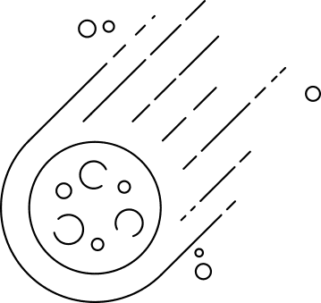

Brief Business Problem
As per a recent case in Berlin, an artist managed to create a virtual traffic jam as seen on maps on one of the main bridges, with nothing but a handcart and 99 second-hand phones. This shows that the current technology that is being used cannot be totally relied on, as it only uses GPS tracking.
If the user wants to pre-plan their journey, this cannot be done using the current technology which is in use, as it shows only the live traffic and we cannot ensure that the live traffic will be same when the user reaches the location. Current users can’t pre-plan their journey before time.

Slide 3

Proposed Solution
The above problem can be solved by predicting the future traffic on the basis of legacy data and several other factors which are:
Point Of Interest(POI) like schools, hospitals and locality
Time
Weather conditions
Distance
In future, The realibility can further be increased by integrating the live traffic data, which is currently the only parameter being used by the current technologies.

Slide 4
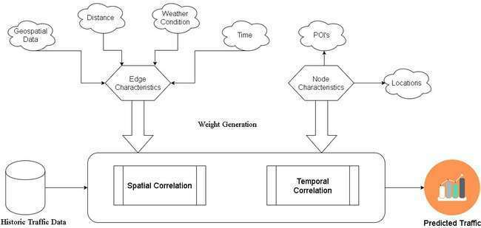
Proposed Solution

Slide 5


Proposed Techstack
Seasonal
Autoregressive Integrated Moving Average
Autoregressive Integrated Moving Average
Python3
Meta Learning
RNN
LSTM

Slide 6

Market Positioning
Public Transport
Can be used by everyone to save time
Transportation Industry
Traffic can be predicted and the journey can be planned accordingly
Food Delivery
Car Pooling
"On Time Or Free" offers can be benifited
Journey can be predetermined .

Slide 7


Effort & Cost
of Implementation
1
Effort: Person Hours : 3 Person *(6 hours * 6 days * 3 weeks ) = 324 hours
2
Software Cost : Licensed Software's Cost

Slide 8

Theme Alignment
Data Science

Slide 9
Industry Alignment
Consumer - Transportation

